Slide 1
3: Input Validation and GUI Implementation

Slide 2
Software Specification
Consideration (analysis) of the software’s requirements give rise to design questions:
What form of GUI will be used? (provided)
What classes are required?
What class members are needed?
Are any other functions necessary?
Essentially the problem is to broken down into component parts or tasks to make it more manageable. Each of these are tackled, solved and tested and then combined and tested to provide an overall solution to the problem. This might be termed incremental development.

Slide 3
Some Design Decisions
GUI – (to be provided) on paper, draft out how the interface is to appear. Indicate the types of widgets to be used, their proposed names, likely size and location (pixels) Outline the likely dialogue between user and system. Require a class to implement the GUI.
The requirement is to solve one Sudoku problem. However, this might be replicated. Accordingly, it is reasonable to prepare to solve more than one problem. This would suggests a identifying a class, say Problem, with members to specify the problem, its solution and the means to determine this solution.

Slide 4
Initial GUI Design
A grid will be formed using 81 textFields. Data entry to specify the problem will be validated.
Acceptable values: integer numbers between 1 and 9 inclusive will be redisplayed in blue with pink background.
An invalid entry will be reported and, on acknowledgement, cleared from the cell.
Exit

Slide 5
Use Case Analysis
<<includes>> applies when there is a sequence of behaviour that is used frequently in a number of use cases.
Specifies Sudoku Problem
<<includes>>
Enters number
User

Slide 6
Use Case Analysis – cont’d
Use case: Enter number
Alternative action: If user does not enter a valid number – a single digit in the range 1 to 9 inclusive that has not already been used (already present in the row, column or box), the system informs the user that input is invalid. The system will reset the cell to null and the user may then make another entry.
Actor Action | System Response
1. User selects cell and enters number | 2. redisplays number in cell in blue with pink background

Slide 7
Input Validation
Consider possible invalid input in a given cell:
Null entry – pressed enter before entering any digit
Length not equal to 1 – more than one digit
Entry not digit
Zero entered
Digit already used – in row, column or block

Slide 8
Test Plan: Input Validation
Test Plan: Decision table - Identify possible entries
Test Case | Input |  |  | Validation result
 | Test | Description | Entry | True/False | Expected outcome
1 | testValidEntry1 | Blank entry | null | False | No action
2 | testValidEntry2 | More than 1 char | “22” | False | Error message
3 | testValidEntry3 | Not digit | “w” | False | Error message
4 | testValidEntry4 | Zero | “0” | False | Error message
5 | testValidEntry5 | Number used | “5” | False | Error message
6 | testValidEntry6 | Number not used | “3” | True | No action

Slide 9
Input Validation - Flow diagram
Draft sequence of checks by means of flow diagram:
No
Not Null
Yes
No
length = 1
Error message1
Yes
No
numeric
Error message2
Yes
No
Not zero
Error message3
Yes
Return True
Yes
No
Return False
Not used
Error message4

Slide 10
Input Validation – component functions
//Function: isNull - entry is null
public boolean isNull(String entry, int cellNo) {
return (entry == null);
}
//Function: notCorrectLength - entry not single character
public boolean notCorrectLength(String entry, int cellNo) {
return (entry.length()!= 1);
}
//Function: notDigit - entry not digit
public boolean notDigit(String entry, int cellNo) {
return (!(Character.isDigit(entry.charAt(0))));
}
//Function: notZero - entry not zero
public boolean notZero(String entry, int cellNo) {
return (entry.charAt(0)!='0');
}

Slide 11
Function: validEntry
//Function: validEntry - valid entry
public boolean validEntry(String entry, int cellNo) {
if(isNull(entry, cellNo)) return false;
if(notCorrectLength(entry, cellNo)){
System.out.println("Invalid entry – More than one character.");
return false;
}
if(notDigit(entry, cellNo)){
System.out.println("Invalid entry – Not a digit.");
return false;
}

Slide 12
Function: validEntry - cont’d
if(!(notZero(entry, cellNo))){
System.out.println("Invalid entry – Not a digit 1 - 9 inclusive");
return false;
}
int number = Character.digit(entry.charAt(0),10);
if(!(numberNotUsed(number, cellNo))){
System.out.println("Invalid entry – Digit already been used");
}
return true;
}

Slide 13
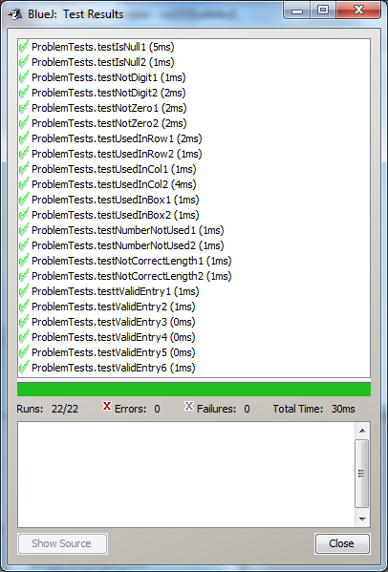
Testing
Functions are added to Problem class.
Further test cases are introduced into ProblemTests to verify latest functions:

Slide 14
Problem Class modification
Require:
name of field array values to be changed to startValues.
Accessor to obtain values of elements of startValues.
Mutator to set value of an element of startValues.
public int getStartValues(int row, int col){
return startValues[row][col];
}
public void setStartValues(int row, int col, int number){
startValues[row][col] = number;
}

Slide 15
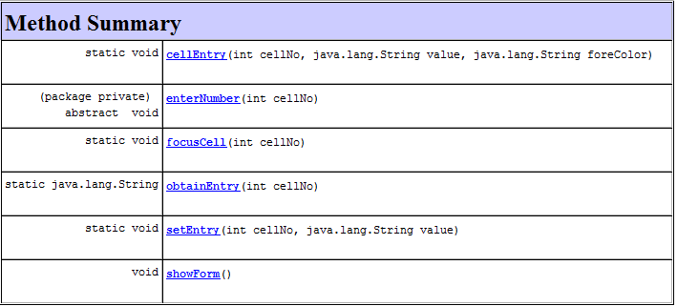
Abstract Class: ProblemGrid
The implementation in Java of a GUI is covered in CO520 Further Object Orient Programming. Consequently an implementation containing various methods is made available via the ‘Courses’ folder on Raptor.
Javadoc: ProblemGrid Methods

Slide 16
Abstract Class: ProblemGrid – cont’d
Various static methods are listed and these are used within ProblemGrid.
One abstract class: enterNumber is indicated. This method is to be implemented within a sub-class: MyProblemGrid which inherits the members of ProgramGrid.
public class MyProblemGrid extends ProblemGrid {
private Problem problem = new Problem();
public MyProblemGrid(){
}
public void enterNumber(int cellNo){
………………………….
}
}

Slide 17
enterNumber( )
Design:
Set row to cellNo /9
Set col to cellNo mod 9
To remove previous entry
cell occupied
No
Yes
Obtain entry
Set array element to 0
Set cell to space Format black on white
entry valid
No
Need to reference /set corresponding array element in startValues of problem
Yes
Store entry Format blue on pink
Set cell to null
End

Slide 18
enterNumber( )
public void enterNumber(int cellNo){
int row = cellNo / 9; //Identify row position
int col = cellNo % 9; //Identify column position
if(problem.getStartValues(row, col)!= 0){
problem.setStartValues(row, col, 0);
cellEntry(cellNo, null, "black");
}else{
String number = obtainEntry(cellNo);
if(problem.validEntry(number, cellNo)){ //Check entry
problem.setStartValues(row, col, Integer.parseInt(number)); //Store valid entry
cellEntry(cellNo, number, "blue"); //Display entry blue on pink
}else{
cellEntry(cellNo, null, "black"); //Clearing cell and resetting format
}
}
}

Slide 19
Testing GUI
This is carried out manually.
Accordingly the previous function testing is repeated and any required formatting confirmed.
Test | Input |  |  | Validation result
 | Test | Description | Entry | True/False | Expected outcome
1 | testValidEntry1 | Blank entry | null | False | - | White/black
2 | testValidEntry2 | More than 1 char | “22” | False | Error | White/black
3 | testValidEntry3 | Not digit | “w” | False | Error | White/black
4 | testValidEntry4 | Zero | “0” | False | Error | White/black
5 | testValidEntry5 | Number used | “5” | False | Error | White/black
6 | testValidEntry6 | Number not used | “3” | True | - | Blue/pink

Slide 20
Launch Class
Now that a GUI has been introduced, we need the means to create and display the interface.
Accordingly add a new class, Sudoku to the project:
public class Sudoku {
public Sudoku (){
MyProblemGrid gridForm = new MyProblemGrid();
gridForm.showForm();
}
}

